Slide 1

Global Talent Ireland
Information Webinar
Friday, 1st August 2025
14:00 Dublin Local Time

Slide 2
Global Talent Ireland
Webinar Information
This webinar is a comprehensive presentation covering all aspects of the Global Talent Ireland (GTI) Programme 2025 call
You may submit questions by using the Q&A box in the bottom of the Zoom screen
The webinar recording will be uploaded onto the Global Talent Ireland Programme webpage

Slide 3
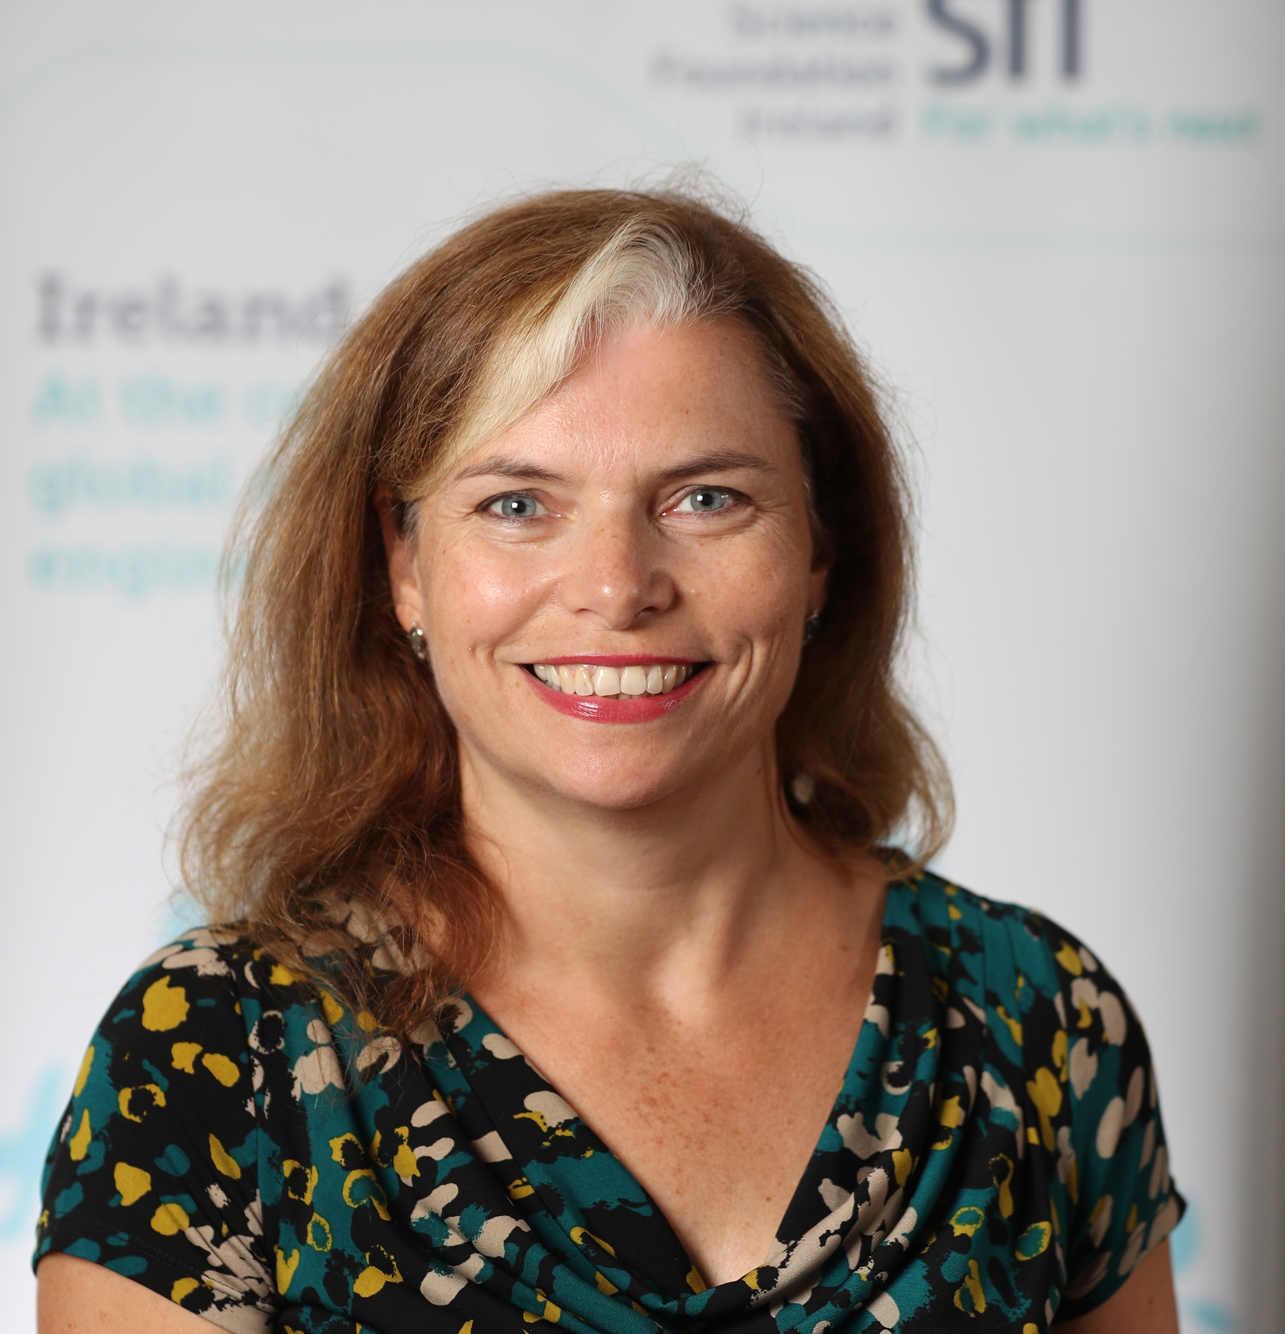
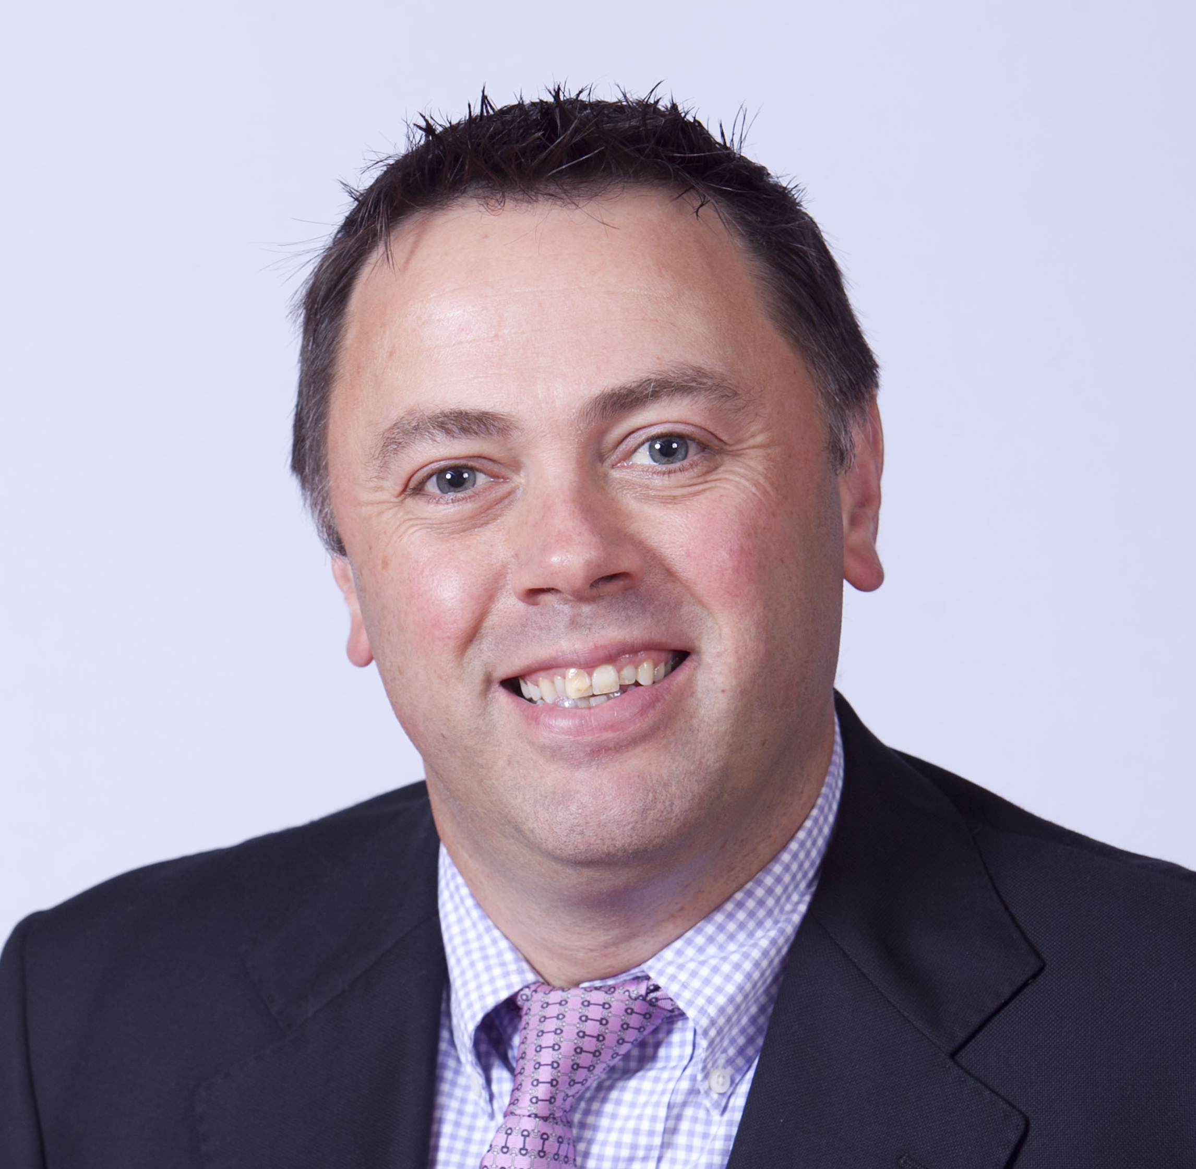
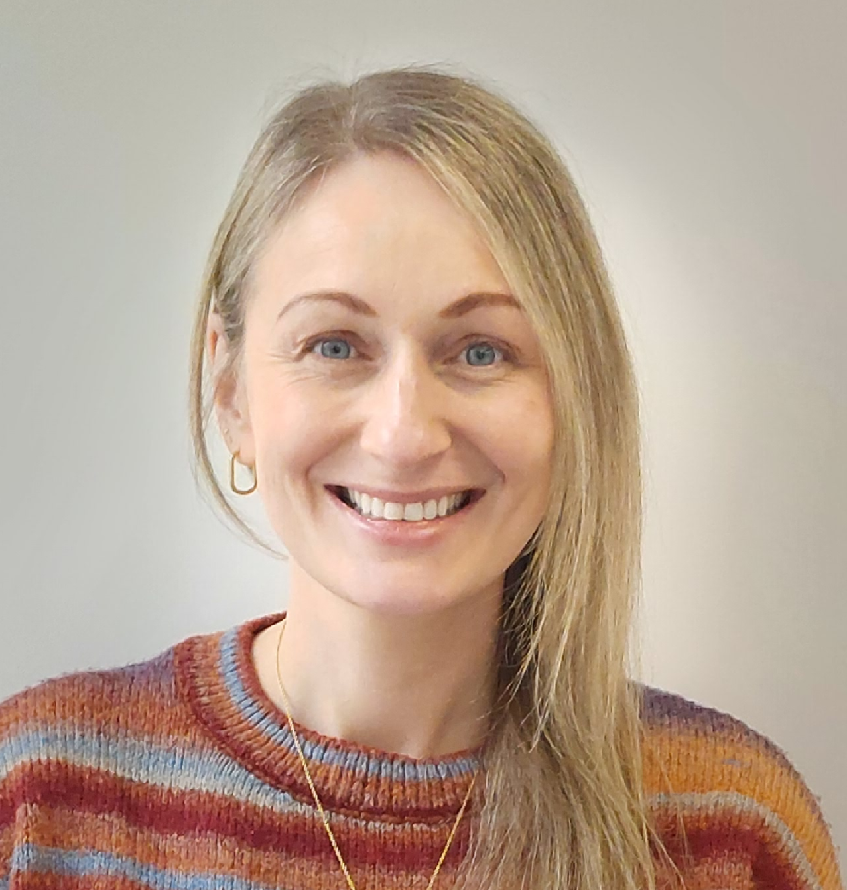

Global Talent Ireland
Global Talent Ireland Programme Team
Roisin Cheshire
Head of Individual-led Research
Graeme Horley
Lead for Fixed-Deadline
Calls, ILR
Nicola McGillicuddy
Scientific Programme Manager
Programme Owner
Angelina van den Akker
Programme Operations Lead

Slide 4
Global Talent Ireland
Format of Presentation
Programme Background, Overview and Objectives
Eligibility Criteria
Application Process – Starting the Process, EOI and Full Proposal
Budget Details
Review process
Timeline
Q&A

Slide 5
Global Talent Ireland
Background:
Research Ireland was established in August 2024 within the Department of Further and Higher Education, Research, Innovation and Science (DFHERIS) following the amalgamation of Science Foundation Ireland (SFI) and the Irish Research Council (IRC).
The establishment of Research Ireland was a key action of Impact 2030: Ireland’s Research and Innovation Strategy.
Expanded Remit:
Object 8 (b) of the Research and Innovation Act 2024 - to support the undertaking of research and innovation in all fields of activity and disciplines by researchers with different levels of knowledge, experience and specialist skills in such fields or disciplines
Remit encompasses both STEM and Arts, Humanities and Social Sciences

Slide 6
Global Talent Ireland
Overview:
Research Ireland have launched the Global Talent Ireland programme on behalf of DFHERIS, with the aim of attracting outstanding mid-career and established international researchers from Irish Higher Education Institutions and public research bodies.
Applications from all research disciplines are eligible to this programme call, where Applicants can provide compelling evidence for their potential to contribute to national development.
Researchers funded through this programme are required to transfer their research activities from their current location to an Eligible Research Body in Ireland

Slide 7
Global Talent Ireland
Objectives of Global Talent Ireland
To attract excellent researchers to Eligible Research Bodies in Ireland
To reinforce the national Research and Innovation ecosystem
To support areas of strategic interest and help drive sustainable economic growth in Ireland

Slide 8
Global Talent Ireland
Funding streams
Rising Star – mid-career researchers who have demonstrated research excellence, independence and leadership, and have shown exceptional potential to become a research leader of the future.
Research Leader - world-leading researchers in their discipline with a demonstrated capacity for strategic and dynamic leadership on the international stage
 | Rising Star | Research Leader
Career Stage | 5-15 years post PhD | 16+ years post PhD
Award Duration | 6 years | 6 years
Research Funding | €1.5M | €2.5M
Startup Funding | €0.75M | €0.75M
Max. Budget Request | €2.25M | €3.25M

Slide 9
Eligibility - Applicants
Global Talent Ireland
Applicants may have been previously employed in an Irish Research Body, but may not be currently employed or have signed a contract with an Irish Research Body at the time of both EoI and full proposal submission to this call.
For this Programme, Ireland is the island of Ireland – Applicants currently employed in Research Bodies in Northern Ireland are not eligible to apply. Research Bodies located in Northern Ireland may not act as host institutions for this programme.
Successful Applicants may not hold another appointment once the Global Talent Ireland award commences.
Applicants who currently hold another significant grant may apply (e.g. ERC grants) but must clearly describe how both awards will be managed.
Joint Appointments whereby Applicants propose to hold a contract of employment in Ireland, and another country concurrently will not be supported through this programme.

Slide 10
Global Talent Ireland
PhD requirements
The official date of a PhD is defined as the year printed on the official PhD certificate. The number of years is determined by the calendar year only.
Rising Star stream - PhD certificate dated from 2010 to 2020.
Research Leader stream - PhD certificate no later than 2009.
Eligible Leave – periods of eligible leave such as maternity, sickness, etc can be taken into account when including years post PhD.
PhD equivalence – applicants should check PhD equivalence policy (link in call document)

Slide 11
Global Talent Ireland
Funding streams
Rising Star – mid-career researchers who have demonstrated research excellence, independence and leadership, and have shown exceptional potential to become a research leader of the future. They must:
Have obtained a PhD qualification (or equivalent) within 5-15 years of the current year (eligible leave will be considered)
Have an outstanding track record commensurate with their career stage and their field(s) of research
Have secured independent research funding from competitive publicly funded sources as a Lead Investigator or Co-Investigator
Have experience of supervising MSc- and/or PhD-level students
Have demonstrated international standing (e.g., peer review, keynote talks, collaboration, conference and workshop organisation, etc.) as an indicator of research maturity

Slide 12
Global Talent Ireland
Funding streams
Research Leader - world-leading researchers in their discipline with a demonstrated capacity for strategic and dynamic leadership on the international stage
Have obtained a PhD qualification (or equivalent) at least 16 years prior to the current year
Hold a full professorial position at a major international research institution or an equivalent senior research-active role in an industrial setting
Demonstrate influential research (achievements and excellent generation of knowledge)
Have a proven track record of strategic and dynamic leadership and development of talent
Senior authorship of literature with demonstrable impact in relevant field(s) of interest
Significant international awards and fellowships
Plenary/keynote contributions at top-tier international conferences, and organisation of such meetings of importance
Distinguished service record on national or international grant review boards
Successful track record in securing independent funding from competitive, publicly funded sources

Slide 13
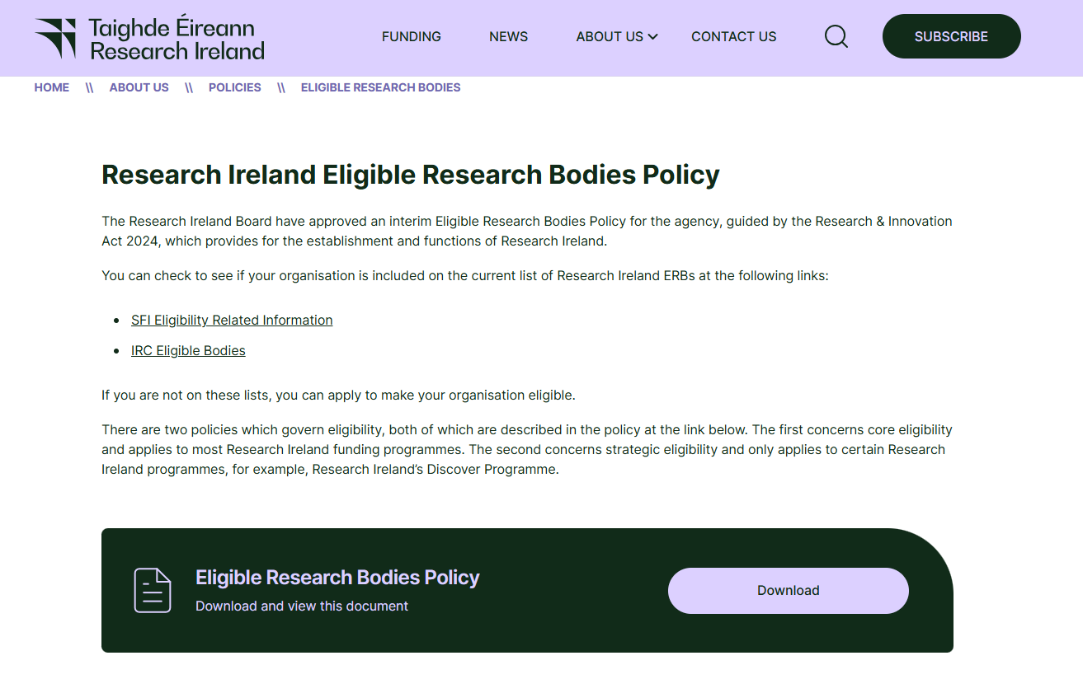
Global Talent Ireland
Eligibility of the Research Body
The Research Body is the body responsible for the overall financial and administrative coordination of the research programmes supported by funding from Research Ireland.
All eligible host Research Bodies are situated in the Republic of Ireland. Research Bodies in Northern Ireland are not eligible to act as host Research Bodies for this call.
The full list of eligible Research Bodies is available on the Research Ireland website.

Slide 14

Global Talent Ireland
Pre-submission
Identification of host Research Body
Eligible Research Bodies available on Research Ireland website
Stage 1: Expression of Interest
Submission by host institution via email
Template provided on GTI webpage
28th August 2025, 13:00 Dublin local time
Two-Stage Application Process - Overview
Stage 2: Full Proposal
Submission through SESAME by applicant
Invited following successful EoI assessment
October 2025, Date TBD

Slide 15
Global Talent Ireland
How to Apply – Starting the Process
Potential applicants interested in applying to the Global Talent Ireland 2025 call should identify a Research Body that aligns with their research aims/objectives and contact the relevant Research Offices/Head of School (or equivalent) to start discussions on potential recruitment.
The full list of eligible Research Bodies found on Research Ireland website and call document.
Research Ireland is not involved in connecting potential applicants with Research Bodies.
Research Bodies should consider potential applicants where the proposed research aligns with the strategic objectives of the research body, and who are most likely to contribute to national development.
There are no restrictions on the number of Expressions of Interest submitted by any Eligible Research Body. However, it is expected that Research Bodies are strategic with their submissions and ensure that they can provide the necessary support to each Applicant to ensure the intended impacts are realised.

Slide 16
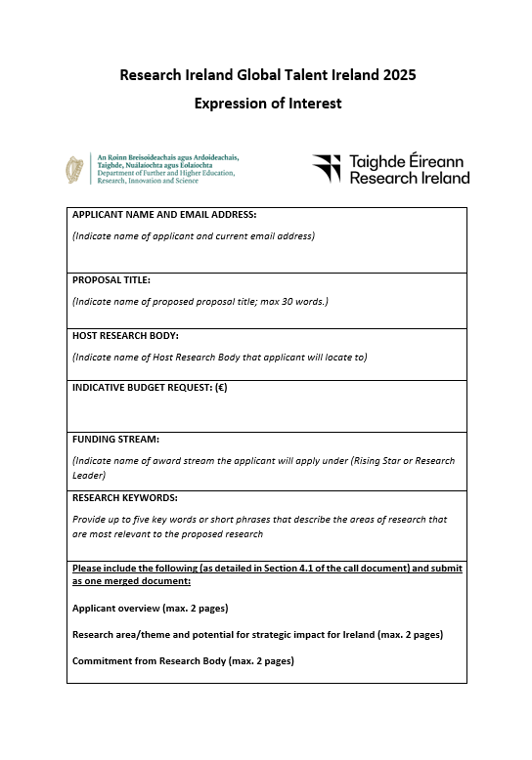
Global Talent Ireland
Expression of Interest
Research Bodies seeking to apply to Global Talent Ireland must first submit an Expression of Interest (EoI) for each Applicant that they wish to support. Each Applicant requires a separate EoI template to be completed.
The EoI template is provided on the Global Talent Ireland webpage.
EoIs should be signed by a member of the relevant Research Office staff and submitted in a single email communication to globaltalent@researchireland.ie, with each EoI attached individually (i.e., not merged).
EoIs must be received by Research Ireland no later than 28th August 2025, 13:00 Dublin Local Time.

Slide 17
Expression of Interest
Global Talent Ireland
Applicant name and email address
Proposal Title: Indicate name of proposal title (subject to change at full proposal stage)
Host Research Body: Indicate name of Host Research Body that applicant will locate to
Award Stream: Indicate name of award stream the Applicant will apply under (i.e. Rising Star or Research Leader)
Research Keywords (maximum 5 keywords)
Applicant Overview (maximum 2 pages)
Research area/theme and potential for strategic impact for Ireland (maximum 2 pages)
Commitment from Research Body including budget request (maximum 2 pages)
Details may be modified when completing the Full Proposal to this call. However, Research Ireland expects the information in the Full Proposal to be broadly consistent with the information submitted under the Expression of Interest.

Slide 18
Expression of Interest
Global Talent Ireland
Following submission of EoIs, an advisory board will be convened to advise on the alignment of proposals with areas of significant strategic interest for Ireland.
In the event of a very high volume of applications, Research Ireland may implement a triage step to reduce the number of proposals at the review stage.
Triage decisions may incorporate input from the advisory board regarding national strategic alignment and level of co-funding from the host institution.

Slide 19
Global Talent Ireland
Full Proposal Submission
Full Proposals will only be accepted through SESAME, Research Ireland's grants management system following the successful assessment of an EoI. Applicants whose EoIs have been approved by Research Ireland will receive formal notification inviting them to submit a Full Proposal through the SESAME system.
Access to SESAME is controlled by staff at the Research Office of the host Research Body.
Proposals must be submitted online through SESAME to Research Ireland by the Research Office of the Applicant’s host Research Body.
Please note that the full proposal deadline includes the necessary time for review and formal endorsement from the Research Office at the host Research Body. The submission is not considered complete until it has received this endorsement, and the Research Office has officially submitted the application through SESAME to Research Ireland.
The SESAME system is accessed here: https://grants.researchireland.ie/s_Login.jsp

Slide 20
Global Talent Ireland
Full Proposal Submission
Full Proposal Summary
Proposal Title (maximum 30 words): The proposal title should take the form: Global Talent Ireland: Title and Name of Applicant
Duration of Grant: Global Talent Ireland grants will have a duration of 72 months.
Total Funding Request (in €): This figure will be populated from the requested budget submitted. Please ensure this figure is accurate.
Research Theme (maximum 10 words): This should broadly describe the area(s) of research that the applicant and their team will undertake following their recruitment to Ireland.

Slide 21
Global Talent Ireland
Full Proposal Submission
Applicant Details
Location of Applicant at time of Submission: (Country)
Time Commitment to Grant (%) - the % of your total working time that will be dedicated to research funded through this grant
Narrative CV: A CV of the Applicant, using the template provided on the programme website, must be completed and uploaded (maximum 5 pages). The template allows for the provision of additional information such as periods of leave from research if relevant. Applicants who do not use the template provided and who do not adhere to guidance provided on the Research Ireland website will be withdrawn without review.
https://www.sfi.ie/funding/sfi-policies-and-guidance/narrative-cv-dora
Supervisory Experience – Applicants should enter a summary of information on their supervisory experience to date.

Slide 22
Global Talent Ireland
Full Proposal Submission
Applicant Details
Research Funding History - Applicants should enter their expired, current and pending funding here. Full guidance on this is found in Section 4.6 of the programme call document.
Applicants should only include funding where they are either the Principal or Co-Investigator.
Grants most relevant to the proposed research should be prioritised.
If this section is left blank it will be assumed that the Applicant has NO expired, current or pending funding.

Slide 23
Global Talent Ireland
Full Proposal Submission
Main body of Proposal
Keywords (maximum 15) - descriptors that best characterise the proposed research.
Research Abstract (maximum 250 words) This should be a succinct and accurate summary of the proposed research.
Lay Abstract (maximum 150 words) This should be a succinct and accurate summary of the proposed research in lay, non-technical language.
Ethical Issues: Use of Animals - Applicants must indicate whether animals are to be involved in any of the planned research. Further details can be found on the Research Ireland Ethical Policies webpage.
Research Involving Human Participants, Biological Material or Identifiable Data Applicants must complete the questionnaire indicating whether their planned research will involve human participants, human biological material or the use of identifiable (or potentially identifiable) human data.
Clinical trials and investigations requiring approval by the Health Products Regulatory Authority (HPRA) will not be permitted through this programme.
Sex and Gender Dimension in Research Statement (maximum 1000 words) - Applicants must complete a statement articulating the consideration of biological sex and/or social gender variables in their planned research.

Slide 24
Global Talent Ireland
Full Proposal Submission
Programme Documents
Research Plan (maximum 4 pages): Applicants are required to summarise their plans for the research activities that will be carried out under a Global Talent Ireland grant. The Research Plan should cover the following:
Research Idea – What are you going to do? This should cover the question(s) that the proposed research would address, the importance or significance of addressing the question(s) and the potential originality or novelty of the question(s).
Research Plan: How are you going to do it? key objectives/work packages to achieve the research aims; key methods or approaches.
Fit with Ireland: What is your motivation for bringing your research programme to Ireland?
References (maximum 1 page) References and citations to support the research objectives must be uploaded in a separate one-page document.

Slide 25
Global Talent Ireland
Full Proposal Submission
Programme Documents – Statement on Impact
Research Ireland funds research on behalf of the Government of Ireland. As with all public spending, it is both desirable and necessary to show value for money and, within this, demonstrate and articulate the impact and benefits of investing in research.
Impact Statement (maximum 3 pages) The impact statement should outline how the proposed research will align with Ireland’s national strategic interests and contribute to national development. The Impact statement should be as specific as possible and should clearly reference relevant institutional and national policies. The Applicant is expected to provide detail on the likely timeframe required to deliver on the described potential impact(s). The following points should be considered:
How will the proposed research align with Ireland’s national strategic interests and contribute to national development?
How will the proposed research reinforce the research and innovation ecosystem and contribute to sustainable economic growth in Ireland?
How will talent be recruited and developed under their leadership?
How will this funding be leveraged to secure competitive European/international funding?

Slide 26
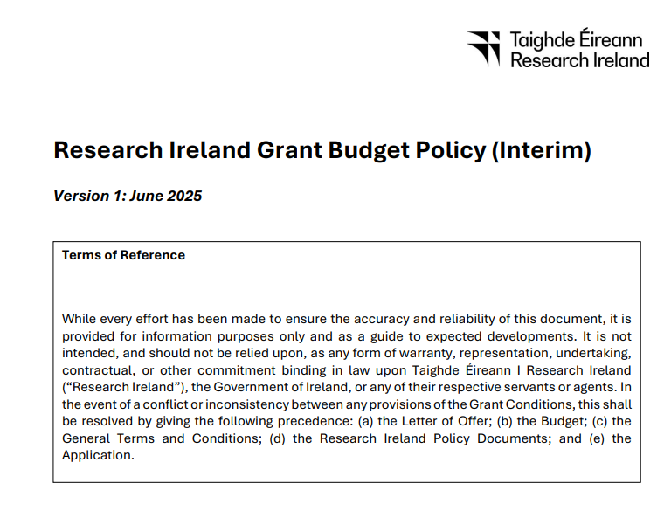
Global Talent Ireland
Full Proposal Submission
Programme Budget
Applicants applying to the Global Talent Ireland call may request funding up to the maximum amounts allowed for Rising Stars (€2.25M) or Research Leaders (€3.25M).
The requested budget consists of two parts: Research Funding and Startup Funding.

Slide 27
Global Talent Ireland
Full Proposal Submission
Research Funding
Research Funding through this programme supports the research costs of the Applicant and their research team. Eligible costs include:
Contributions to salaries/stipends for staff hired specifically to carry out the research programme.
Relevant research expenses, including equipment, materials and consumables, and travel.
Access charges for the use of large items of infrastructure or testbed facilities may be requested in certain situations; see the Research Ireland Grant Budget Policy for details.
Contributions to Education and Public Engagement activity, organisation of conferences or workshops, and hosting of visiting researchers and fellowships.
Please consult the Research Ireland Grant Budget Policy (GBP) for more information on the eligible costs listed.

Slide 28
Global Talent Ireland
Full Proposal Submission
Startup Funding
Global Talent Ireland provides additional funding to provide key support to new recruits to Ireland. The Startup Funding component may be utilised for the following:
Contributions to the salary of the grant holder. Where a salary contribution is being sought, the budget should clarify the percentage contribution to the total salary being requested.
Large-scale items of equipment
Institutional startup packages
Access to large-scale infrastructure or facilities not located at the host Research Body
Other major experimental and field work costs where justified
Please consult the Research Ireland Grant Budget Policy (GBP) for more information on the eligible costs listed.

Slide 29
Global Talent Ireland
Full Proposal Submission
Completing the budget in SESAME
The budget table should be completed by filling in each appropriate category.
Category | Description | Overheads Applicable
Staff | Include a separate line for each staff member hired to carry out the research programme | Yes
Equipment | Include a separate line for each item of equipment in this section Include a separate line for each startup cost in this section (including a line for the Applicant salary/contribution if being requested) | No
Materials | Include a separate line for each item of materials or consumables in this section | Yes
Travel | Include a separate line for each item of travel in this section | Yes
Research Ireland also makes an indirect or overhead contribution to the host Research Body, which is reflected as a percentage of the direct costs (30% of the combined costs for team member salaries/stipends, materials and consumables, and travel, but not equipment, and in this case, startup costs). General overheads should not be included in the requested budget and are payable as a contribution to the Research Body

Slide 30
Global Talent Ireland
Full Proposal Submission
Budget Justification – Maximum 3 pages
Applicants should complete a budget justification document, outlining the justification of each budget category.
All information required to complete the budget justification can be found in the Research Ireland GBP.
Clear information should be provided where funding is to be apportioned to Collaborators. Please note that Collaborators based outside the Republic of Ireland or those not located within eligible Research Bodies in the Republic of Ireland are not eligible to receive funding through this programme.
If funding is sought for overseas services, this should be clearly justified and the rationale for carrying out this activity outside of Ireland must be explained.

Slide 31
Global Talent Ireland
Full Proposal Submission
Letters of Support
The following letters of support must be included: (maximum 2 pages per letter)
Applicant: An Applicant statement should outline the motivation for moving their research programme to Ireland and their commitment to moving to the new host Research Body in Ireland from their current position.
Vice-President for Research (or equivalent) of the Host Research Body: This letter of support should outline the strategic alignment of the Applicant and proposed research with the host institution and national research and innovation ecosystem.
Head of School (or equivalent) with budget and decision-making capacity: This letter of support should outline the practicalities/operational aspects of the potential recruitment to ensure the Applicant can get up and running quickly. Detail on co-funding should be outlined clearly. The infrastructure, facilities and space to be provided by the Research Body should be included. The letter should also indicate what IP/technology transfer services are provided by the Research Body.

Slide 32
Global Talent Ireland
Full Proposal Submission
Submitting the Proposal on SESAME
A PDF of the proposal is available in SESAME and should be reviewed prior to submission to enable validation of an application. The responsibility for verifying that the proposal is ready for submission lies with the Applicant in this regard.
A submission is made initially to the Research Office of host Research Body for approval, prior to final submission by the Research Office to Research Ireland. Please contact the Research Office well in advance in order to become familiar with any internal Research Body submission deadlines.
Applicants will receive a notification from SESAME periodically when the status of their proposal changes. Alternatively, the status of a proposal (e.g., where a proposal is pending Research Office approval or is under review at Research Ireland) is displayed in SESAME

Slide 33

Global Talent Ireland
Stage 1 – Postal Review
Minimum three international reviewers per proposal
Anonymous review process
Scoring against three review criteria
Two-Stage Review Process - Overview
Ranking and triage step
Stage 2: Interview Panel
In person interview panel
Presentation and questions
Representative from Research Body present
Scoring against three review criteria

Slide 34
Global Talent Ireland
Stage 1 Review Criteria
International experts carrying out the Stage 1 review will assess proposals by considering three review criteria, weighted as indicated below:
Quality, significance, and relevance of the recent research record and career achievements of the Applicant, commensurate with career stage (40%)
Significance and relevance of the outlined research objectives and their potential to progress the field(s) of research concerned (40%)
Quality of the impact statement, considering how the proposed plan may support areas of strategic interest and help drive sustainable economic growth in Ireland (20%)

Slide 35
Global Talent Ireland
Stage 2 Review Criteria (equally weighted)
Likelihood and value to Ireland of the proposed impact of the recruitment and the quality of plans for developing and nurturing talent, including the motivation of the researcher to move to Ireland and their fit within Ireland’s research ecosystem
Strength of the demonstrated commitment from the Research Body, including the financial and infrastructural support offered to the Applicant and alignment with the strategic objectives of the Research Body
Appropriateness of the budget and resources requested and demonstration of value for money

Slide 36
Global Talent Ireland
Stage 2 Post Panel
Following the interview stage, the proposals will be ranked by final score from the panel (based on the criteria above).
If proposals have equal scoring and a need to be ranked further, Research Ireland may use the impact score as a tiebreaker. The input from the advisory board may also be used to inform final funding decisions.
The final funding decision lies with Research Ireland

Slide 37
Global Talent Ireland
High Level Steps/Timeline of Call
Review Process
Call Launch
EoI Deadline
Full Proposal Deadline
Stage 1 Postal Review
Stage 2 Panel Interview
Outcome and Approval
Latest date for LoO
July 2025
August 28th 2025
October 2025
November/December 2025
Q1 2026
Late Q1/Early Q2 2026
December 2026
Triage Step
Triage Step

Slide 38
Quote from Minister Lawless
Global Talent Ireland
James Lawless, Minister for Further and Higher Education, Research, Innovation and Science: "We strongly encourage prospective applicants to begin engaging with Irish research bodies without delay. Ireland offers a stable, dynamic, and globally connected research environment. We are ready to welcome talented researchers who aspire to make a meaningful impact economically and societally, while advancing their careers here in Ireland."

Slide 39
Questions and Answers
Please enter questions in the Q&A box
Be as succinct as possible
Additional questions may be submitted to: Globaltalent@researchireland.ie
Next Steps:
Review call document
Identify and contact potential Research Bodies
Be aware of any internal Research Body deadlines
Global Talent Ireland

Slide 40
Thank You
Contact Us:
Email: globaltalent@researchireland.ie
X: @Researchirel
LinkedIn: research-ireland

